Slide 1
E-retail factors for customer activation and retention: A case study from Indian e-commerce customers
Author : Matta Akhil Reddy

Slide 2
Introduction:
Customer satisfaction has emerged as one of the most important factors that guarantee the success of online store, it has been posited as a key stimulant of purchase, repurchase intentions and customer loyalty.
A comprehensive review of the literature, theories and models have been carried out to propose the models for customer activation and customer retention. Five major factors that contributed to the success of an e-commerce store have been identified as
Service
Quality,
System quality,
Information quality,
Trust and
Net benefit.
The research furthermore investigated the factors that influence the online customers repeat purchase intention. The combination of both utilitarian value and hedonistic values are needed to affect the repeat purchase intention (loyalty) positively. The data is collected from the Indian online shoppers. Results indicate the e-retail success factors, which are very much critical for customer satisfaction.

Slide 3
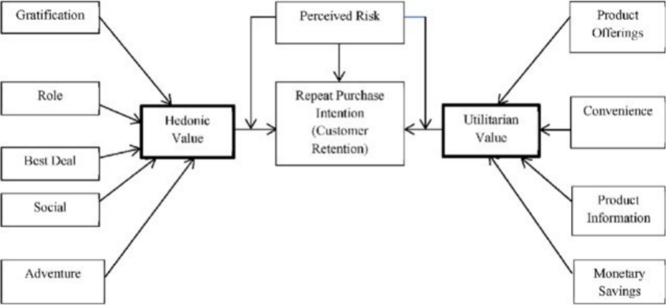
Diagrammatic Representation of Customer Retention Dataset

Slide 4
Diagrammatic Representation Description
As we can see in the diagrammatic representation of the Dataset their are 3 factors which are
making the customer to get the intention of repeating the purchase with the online retailers
Hedonic Value
Utilitarian Value
Perceived Risk
The Hedonic value consists of factors like
Gratification
Role
Best Deal
Social
Adventure
The ulitirian value consists of factors like
Product Offerings
Convenience
product Information
Monetary Savings

Slide 5
Executive Summary
In this project, a data-set was provided containing the details of the participants of a survey,
along with their online shopping experiences, preferences, and opinions regarding various E commerce websites.
Firstly the data has been loaded from the excel sheet and was observed, it was first checked with
null values and then the various feature columns were Analyzed. Exploratory Data analysis was conducted to
investigate the relationships that existed between the columns, using various visualization techniques.
The dataset was worked with to study and understand how various Hedonic values, Utilitarian
values in combination with several perceived risks helped to understand Customer retention and
Loyalty to various e commerce websites.

Slide 6
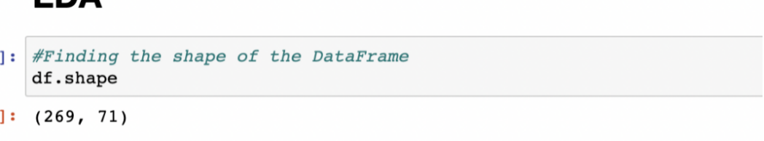
About The Dataset
The given dataset consists of 71 columns and 269 rows.
The column titled : 'Which of the Indian online retailer would you recommend to a friend?' represents a customer’s loyalty to a website and therefore, its customer retention.

Slide 7
Exploratory Data Analysis
The individual columns of the dataset were first analyzed to study their composition and then, with reference to the diagram and the theoretical background of the case study, the relationships between various columns were understood through data visualization using Countplots.

Slide 8
Target
Which of the Indian online retailer would you recommend to a friend? column is treated as target and can be representation of customer Loyalty / Retention since customers who recommend the services of an ecommerce are very highly likely to buy from those websites again.

Slide 9
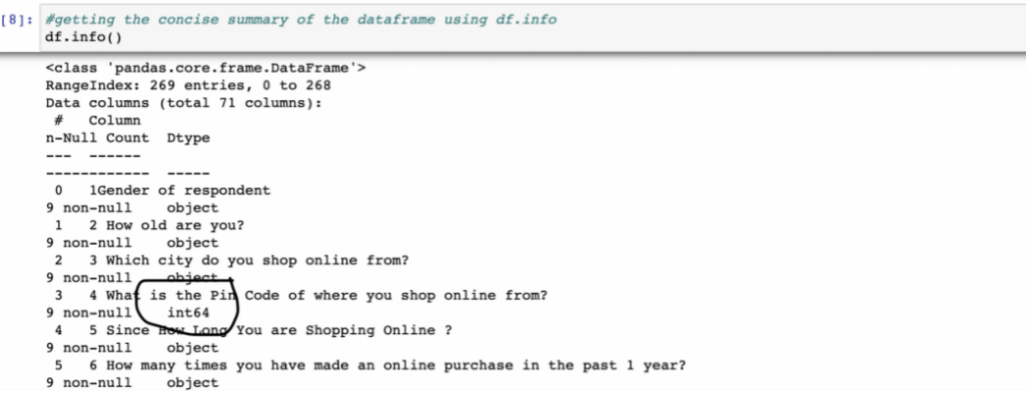
Checking data types of each features.
Except the pin code all others are of object type(categorical variables)

Slide 10

Checking for null values in each column.
There are No null values present in Dataset

Slide 11
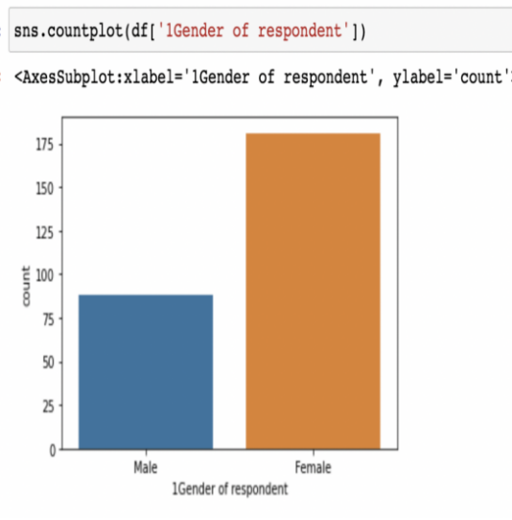
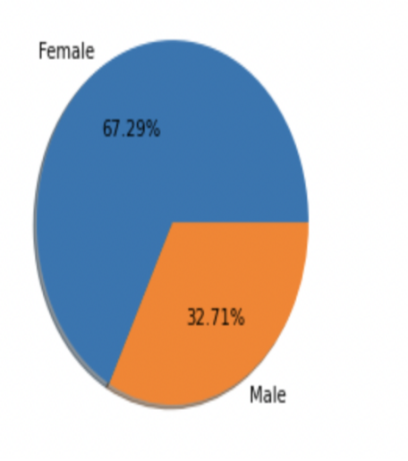
Gender Statistics in the Dataset
The Female's count is more in the Dataset who involved in shopping

Slide 12
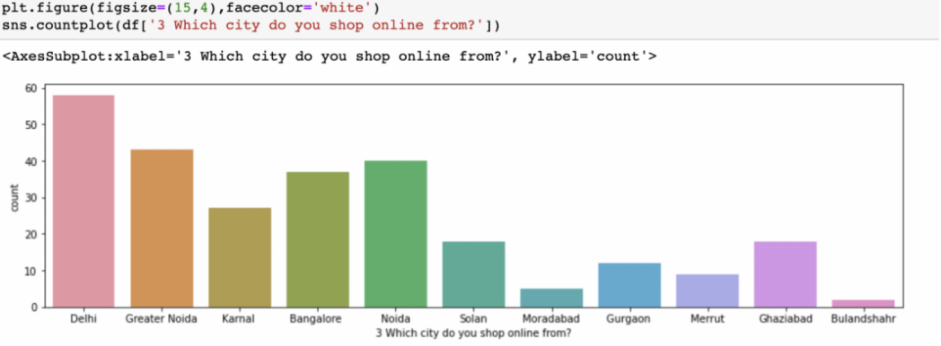
Location from where customers had shopped online
Delhi based located people are involved in shopping more than others

Slide 13
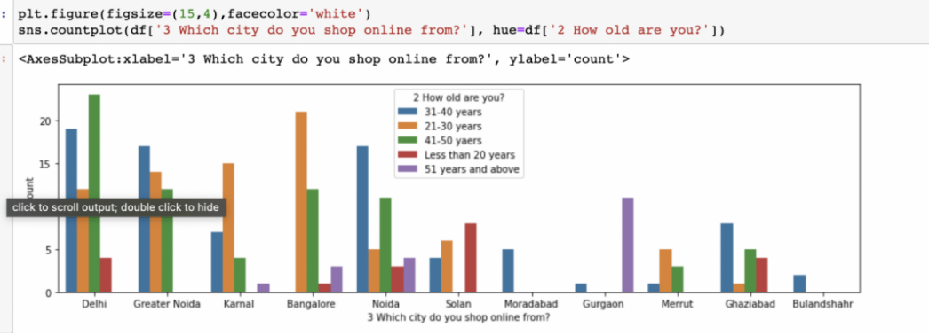
Comparison of shopping based on City and age:

Slide 14
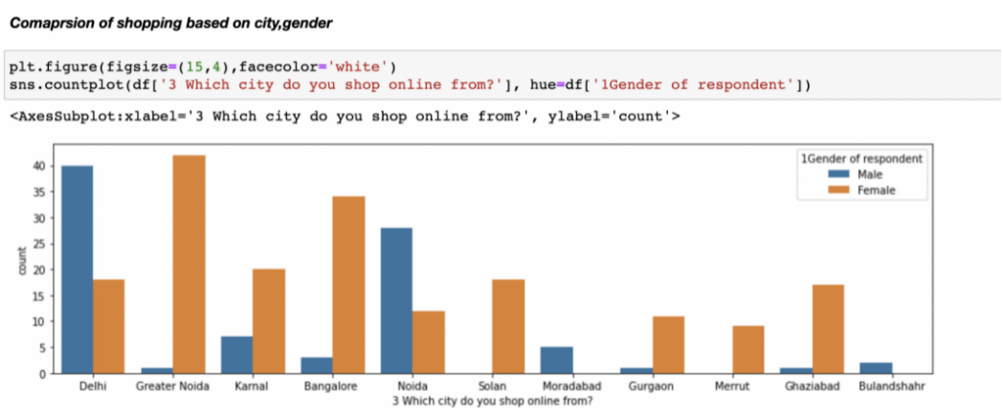
Comparison of shopping based on city and gender

Slide 15
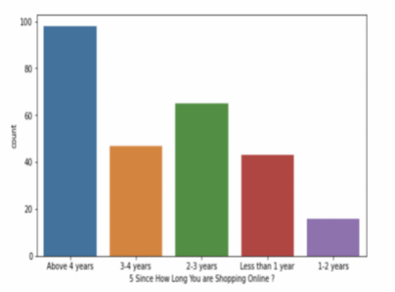
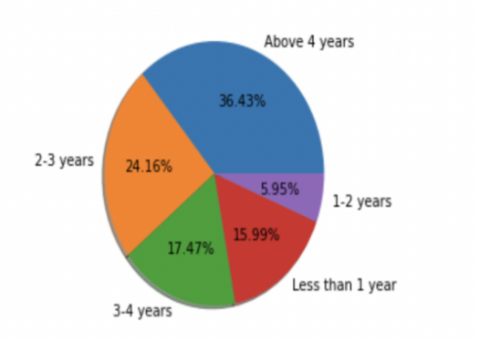
Since how long the people are shopping online
From the data there are many Customers whose are shopping from more than 4 years
There are very less customers who are shopping from 1-2 years

Slide 16
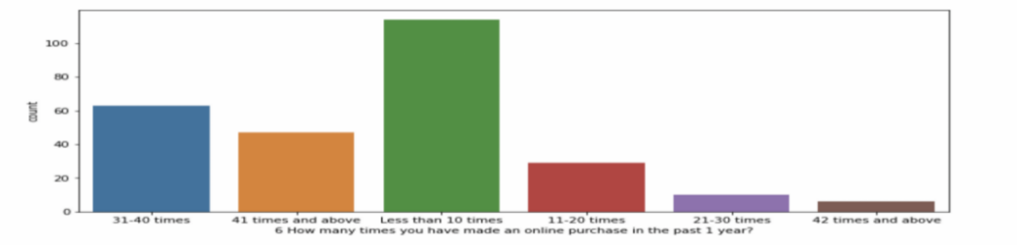
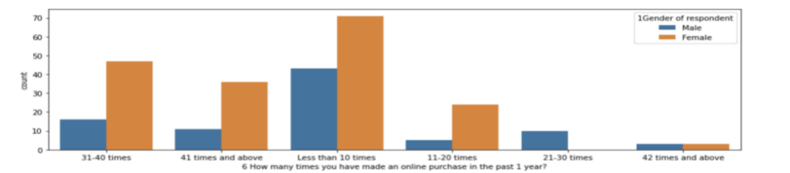
Online Purchases made in past 1 year
In the past 1 year most of the customers has shopped less than 10 times

Slide 17
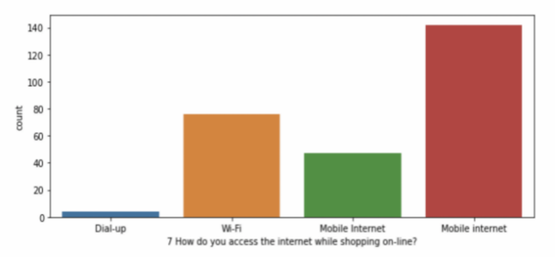
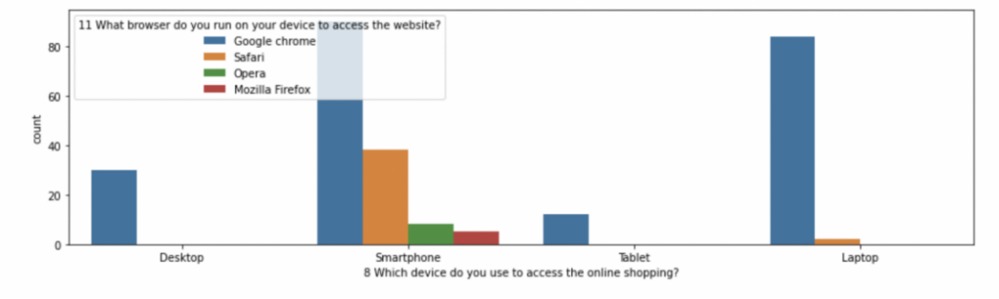
Customers mode of accessing online sites
Most of the customers are using smartphone, Laptop with browser Google Chrome
The desktop users are using only chrome
Most of the Costumers/users are using mobile Internet

Slide 18
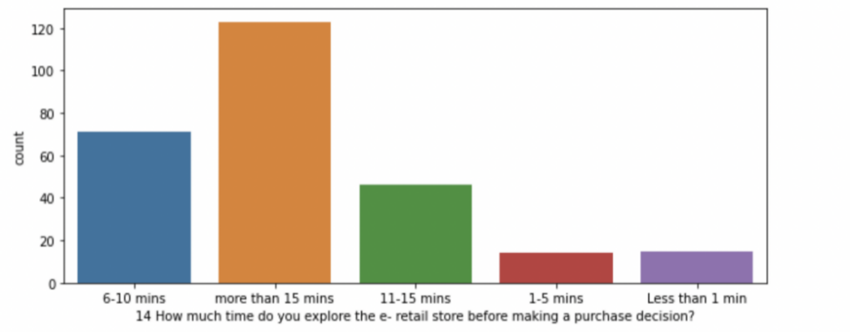
Time spent by customer on e-retail store
Data was saying that most of the Costumer has spent more than 15 mins before making the purchase

Slide 19
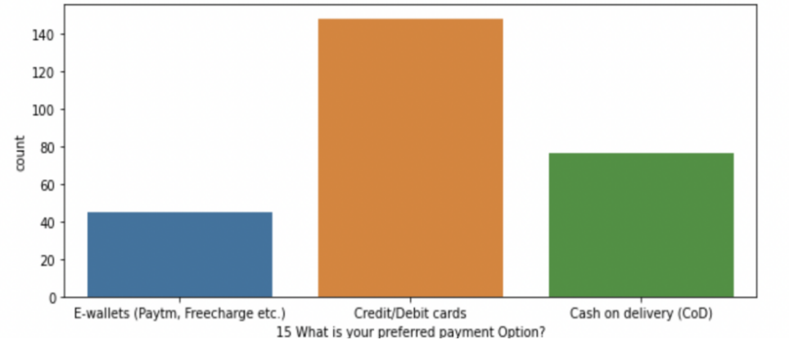
Preferred payment option
Customers most preferred payment option is via credit/debit cards

Slide 20
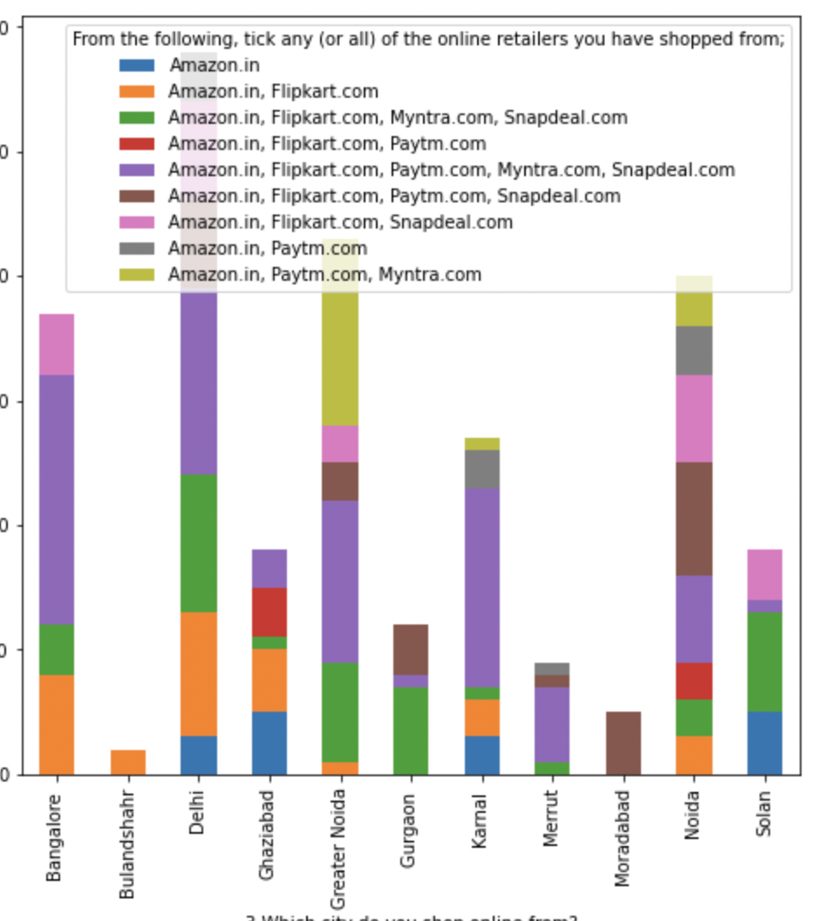
It is observed that Amazon is the most popular E commerce website followed by Flipkart.

Slide 21
Observations
Females have shopped more number of times in last 1 year
Most of the individuals that do online shopping are from the age group 21-30 yrs. and, 31-40 yrs. People below 20 years, &people over 50 years of age do not do much online shopping.
Customers from Delhi, Noida & Bangalore region have shopped most number of times
Most customers who are shopping online from 1 to 4 years have shopped less than 10 times and customers shopping online for above 4 years have highest purchase count in all more than 10 times group
Most customers spends more than 15 minutes before making decision irrespective of the purchase count.
Most of the customers generally preferred credit/Debit cards for payment followed by cash on delivery. Very few customers opt for E-wallet payment.

Slide 22
Observations
Most customers who purchased less than 10 times abandoned the cart due to better alternative offer. Customers purchasing more than 41 times abandoned due to promo code not applied Or better alternative offer
It can be seen clearly that all customers irrespective of the purchase count strongly agree with the empathy which means empathy is very important for customer satisfaction and hence retention. The reason is insecurity amongst the customers. If they have a provision of a helpline number associated with the website, that sense of insecurity vanishes and the customer can trust the website more. A 24X7 support is a must for these online retail stores.

Slide 23
Observations
We can clearly see that return and replacement policy plays an important role in customer satisfaction.
Displaying quality Information on the website improves satisfaction of customers: Most of the customers strongly agreed to this. Shoppers expect online retailers to provide all relevant and accurate information about the product. Providing appropriate information can help online retailers to dispel concerns and fears of consumers towards a particular product or online shopping
Maximum customers agree with online shopping being flexible, irrespective of purchase count as it provides freedom to shop without the influence or pressure from sales staff often encountered in offline stores.

Slide 24
Observations
Customers who have shopped more than 30 times strongly agree that net benefit from online purchase leads to user satisfaction Hence net benefit derived is an important factor for customer retention
Offering a wide variety of listed product in several categories: Customers having purchase frequency of more than 30 times strongly agree to it. It means product variety increases consumers' likelihood of finding a good match with their preferences
Customers with high purchase (>30) agree to get monetary savings
Almost all customers with high purchase agree that they get value for money spent.it indicates that quality of product sold plays an important role in customer retention
Highest number of customers have shopped from amazon, Paytm and Myntra
Highest number of customers like amazon, Paytm and Myntra web page layout
Highest number of customers like amazon and flipkart in terms of variety of product offered
Highest number of customers like amazon and flipkart in terms of relevant and complete description of products

Slide 25
Conclusion
From the above Exploratory Data Analysis, it is determined that for any website to retain customers, for the growth of its customer-base and to build and maintain a successful business, it is important that the E-tailers focus on enhancing customer experience in shopping on their websites, while ensuring that all of their particular hedonic and utilitarian needs are satisfied, while taking steps to minimize the perceived risks. Offering a huge variety of products, impeccable website design, user friendly interface, a huge variety of safe and convenient payment options, offering strong data security and privacy, helpful, empathetic support staff and impeccable customer service, optimized website processes that universally load in optimal time on all types of platforms and systems, faster delivery etc, are vital to ensure customer loyalty to the brand of the e-tailer Experienced customers, give great importance to their experiences of previous purchases, which in turn speeds up the process of attaining their shopping goals.

